Slide 1
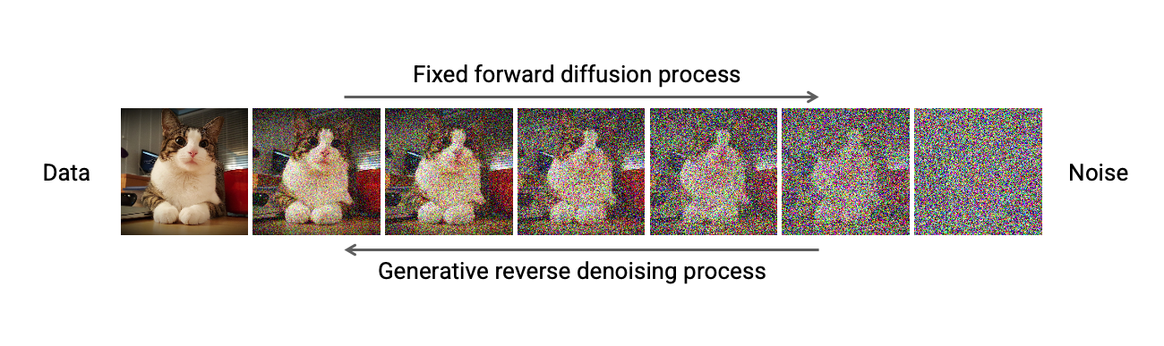
Visualizing and Understanding Diffusion Models: Comparison Experiment and Ablation Study
Sixu Li sxl2199@case.edu
Mingjian Lu mxl1171@case.edu

Slide 2
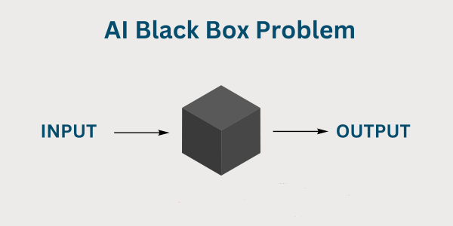
Background
Diffusion models have demonstrated an excellent ability to generate high-quality images.
However, the internal representations learned by those models remain a black box. It is difficult to understand how a particular output is produced or why some certain failures occur.​

Slide 3
Project Motivation and Introduction
We want to have a better understanding of diffusion models, visualizing its architectures and showing its working process. Specifically, we try to understand the internal representations of the models.
In this project, we examined the diffusion models by visualizing the denoising process, plotting feature maps and performing ablation studies.
Our study is based on the work of IDDPM (Improved Denoising Diffusion Probabilistic Model). Stable Diffusion Model was used to generate some images.
Dataset: CIFAR-10 and ImageNet were chosen to train and test the diffusion model. As for the comparison study, we chose BSDS500 to train the U-Net.

Slide 4
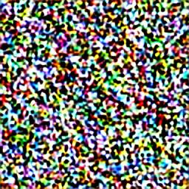
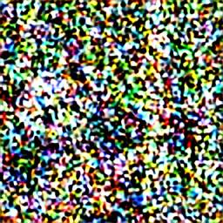
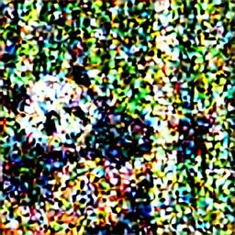
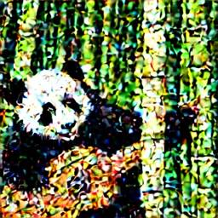
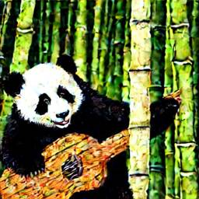

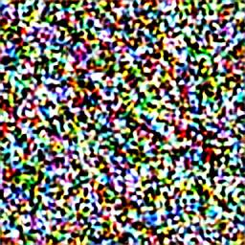
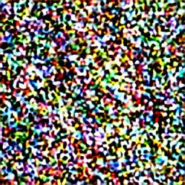
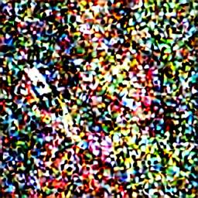
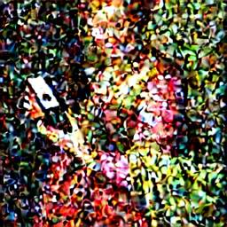
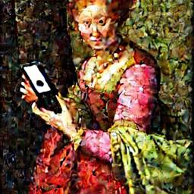

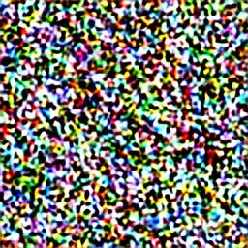
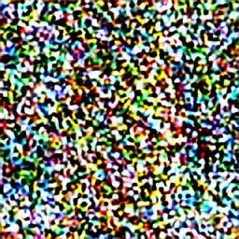
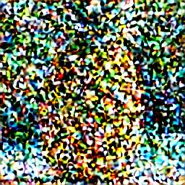
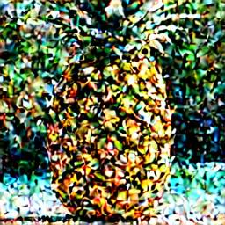
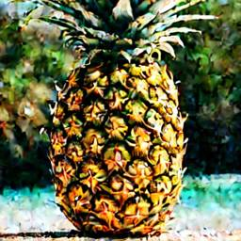
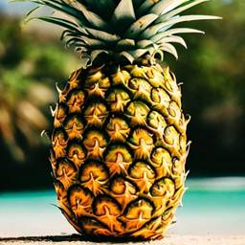
Visualize the Intermediate Sampling Steps
a cute panda playing the guitar in a bamboo forest
a vibrant renaissance portrait of an energetic noble woman, holding an iphone
a pineapple by the water on a beautiful beach
Step 1
Step 10
Step 20
Step 30
Step 40
Step 50

Slide 5
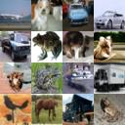
Comparison Experiment on U-Net
U-Net is the backbone network of diffusion models, which follows a classic encoder-decoder design.
As the denoiser, U-Net predicts the noise in the noisy image.
⭐ We try to understand its inner representations. And we want to know why this “U” shaped architecture works well.
Results obtained by running the inference script.
Checkpoint Info: unconditional CIFAR-10, 50M attr, 500K steps
Notes:
That’s why we planned to study the U-Net

Slide 6

Original U-Net Structure
The encoder consists of a sequence of convolutional blocks.
The encoder captures the semantic features of the input images.
The decoder recovers the spatial resolution and reconstructs fine-grained output maps.
⭐The skip connections enable the model to reuse low-level spatial information from the encoder
At the bottom lies the bottleneck layer. The bottleneck layer retains the deepest, most abstract features of the input and connects the encoder and the decoder.

Slide 7
U-Net Structure in Later Diffusion Models (IDDPM)
Conv
Skip connection
Conv
ResBlock × 2
Skip connection
ResBlock × 2
ResBlock × 2
Attention Block
Skip connection
ResBlock × 2
Attention Block
ResBlock × 2
Skip connection
ResBlock × 2
This graph shows the structure of IDDPM’s U-Net. Residual blocks and attention blocks are introduced to improve the performance.
ResBlock
Attention Block
ResBlock

Slide 8
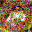
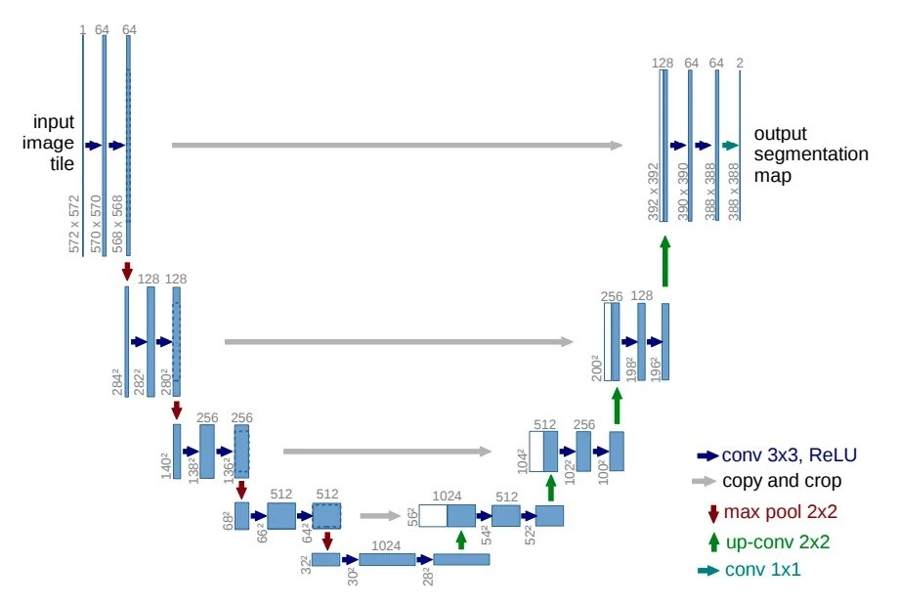
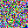
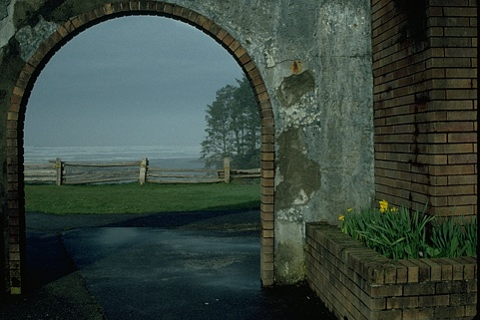
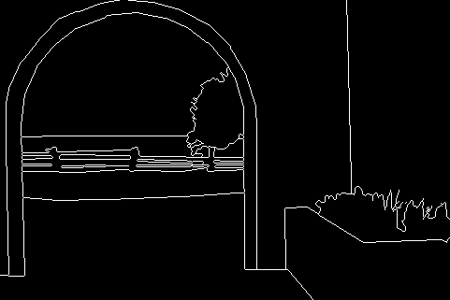

A comparison study
U-Net was firstly used for medical image segmentation tasks. So, we might compare what U-Net learns in image-generation tasks and segmentation tasks​:
Notes:
So this is experiment plan

Slide 9
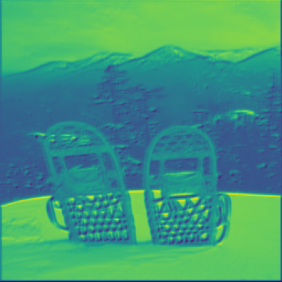
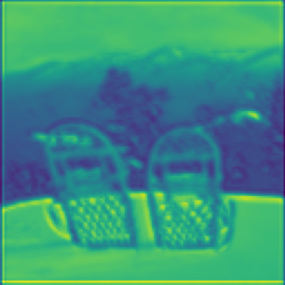
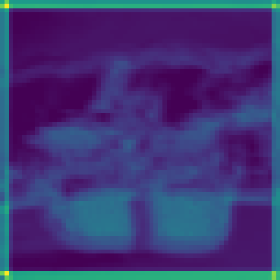
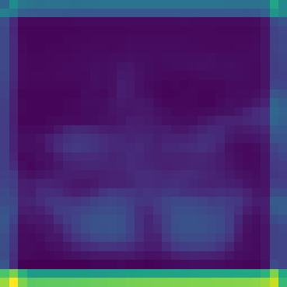
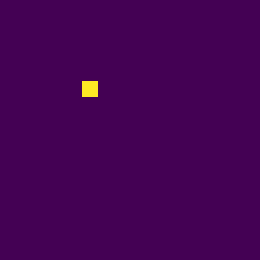
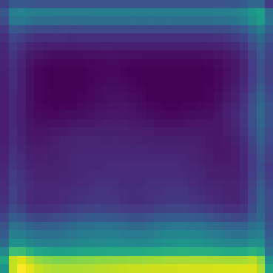
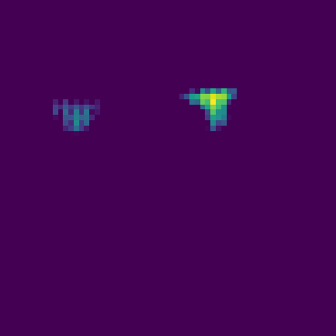
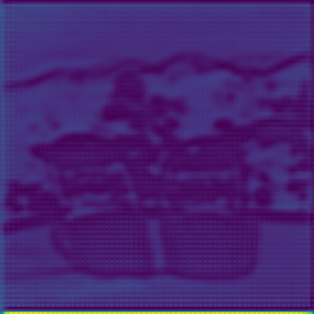
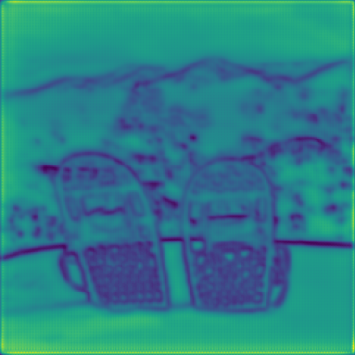
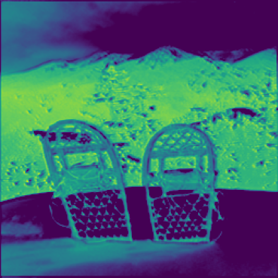
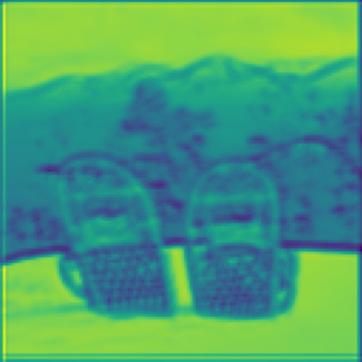




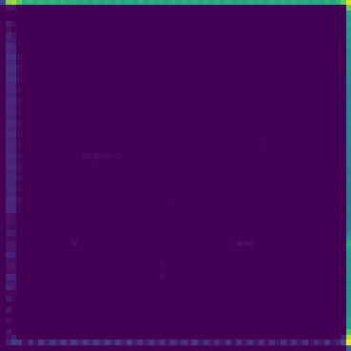
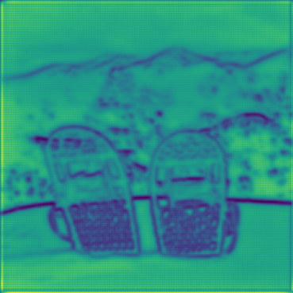
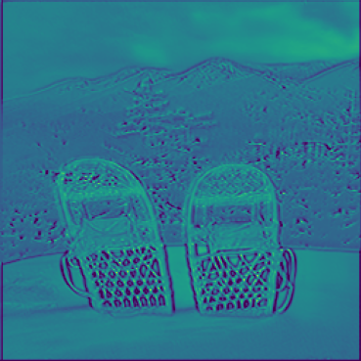
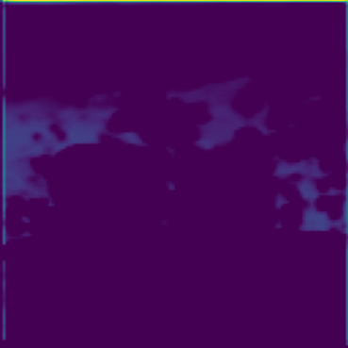


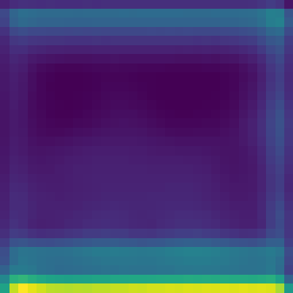
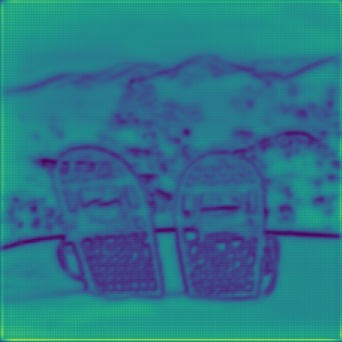
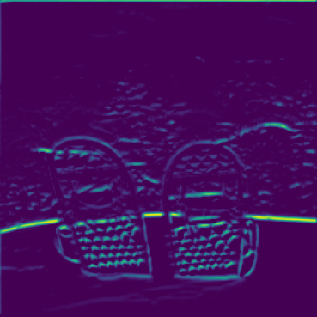
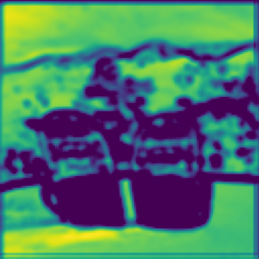
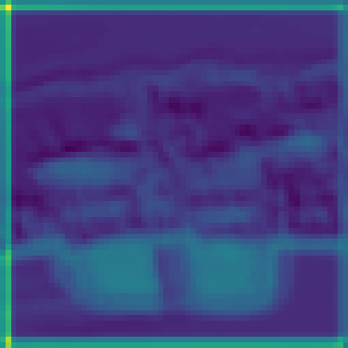
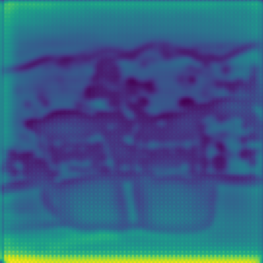
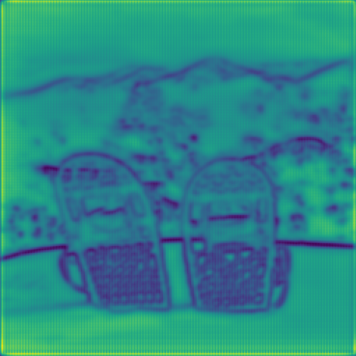
Feature Maps of Segmentation Task

Slide 10
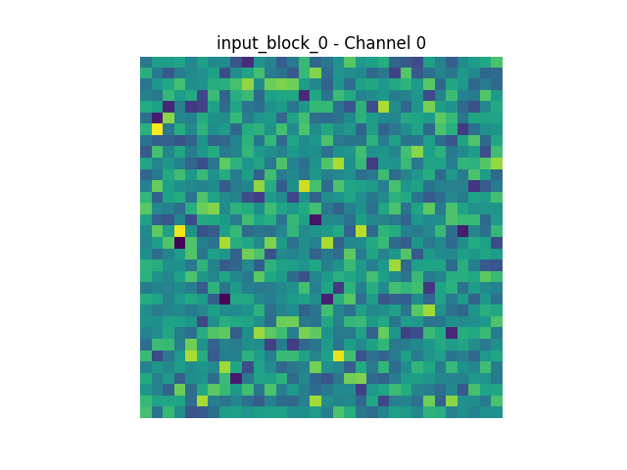
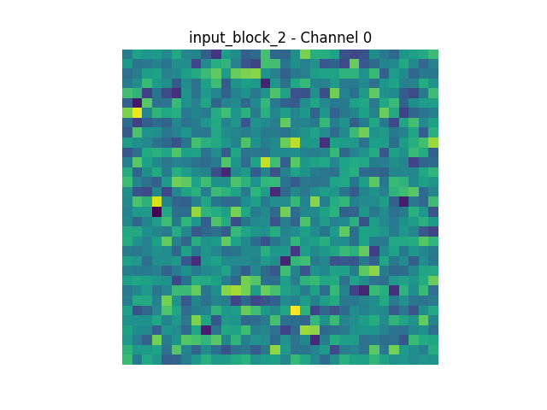
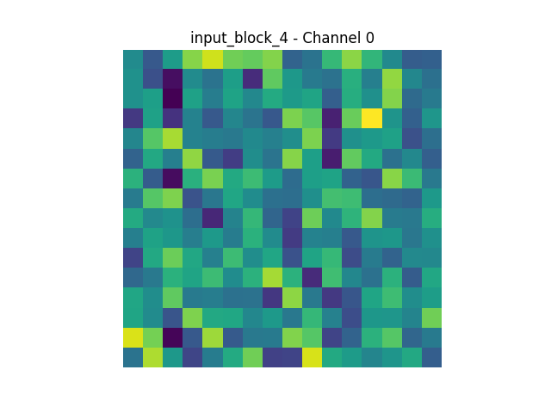
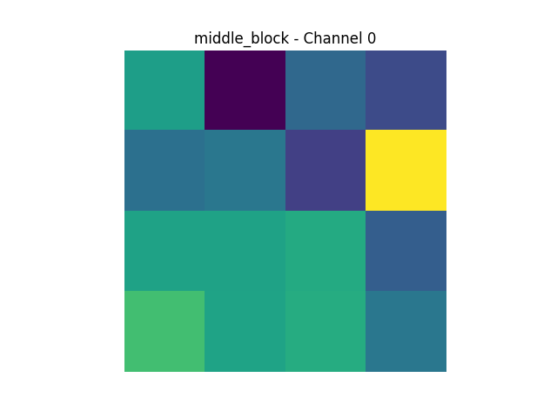
























Feature Maps of Image Generation Task
Input block 0
Input block 2
Input block 4
Middle block
Output block 11
Output block 13
Output block 15
Channel 0
Channel 1
Channel 2
Channel 3

Slide 11
Findings
Through Visualizing the Intermediate Sampling Steps, we found that the general outline and structure of the image are determined in early stages.
We found that diffusion models capture a wide range of characteristics instead of just focusing only on a small set of highly discriminative attributes.
Obviously, the feature maps of diffusion models are quite different from the segmentation task U-Net.
We cannot intuitively see the outline of the image as in the image segmentation tasks.
For feature maps, we can see that the model pays attention to every part of the image, because almost every small area has been "lit up".

Slide 12
Ablation Study of IDDPM on image generation tasks
strategy:Controlled Architecture Variations
Dataset:CIFAR-10
Width (channels_32 vs. channels_64):
Tests how the number of feature maps affects capacity to represent fine details.
Fewer channels ⇒ lighter model, faster iteration; more channels ⇒ richer features.
Depth (res_blocks_0 vs. res_blocks_1):
Compares a shallow vs. deeper residual path.
Additional block increases receptive field and non‑linearity at the cost of extra parameters.
Attention (with vs. without):
Evaluates the role of self‑attention in capturing long‐range dependencies.
Attention modules can reweight spatial features for complex textures.
Conv
Skip connection
Conv
Chanels:32 vs64
ResBlock × 2
Skip connection
ResBlock × 2
Attention Block
Skip connection
Attention Block
ResBlock × 2
Skip connection
ResBlock × 2
Attention Block

Slide 13
Evaluation Metrics
Training Loss
Directly reflects how accurately the denoising network approximates the ground‐truth noise removal (e.g. MSE objective).
Lower loss ⇒ better optimization fit and faster convergence of coarse image structure.
Fréchet Inception Distance (FID)
Measures the statistical distance between generated and real image distributions in feature space.
Lower FID ⇒ higher sample fidelity and diversity as judged by a pretrained Inception network.
Why These Two?
Loss tracks the model’s learning dynamics against its training objective.
FID captures perceptual quality and realism of final samples.
Together, they provide a complete picture of both fit (loss) and quality (FID).

Slide 14


Ablation Study:Loss comparison

Slide 15

Ablation Study:FID comparison
Model Configuration | Loss | Loss Reduction (%) | FID | Relative Improvement
channels_32 | 0.031289 | 96.92 | 321.45 | 0%
channels_64 | 0.001381 | 99.86 | 239.45 | +25.5%
no_attention | 0.002140 | 99.78 | 394.38 | -23.0%
res_blocks_0 | 0.017115 | 98.30 | 366.45 | -14.0%
res_blocks_1 | 0.022420 | 97.76 | 351.36 | -9.3%
Performance after 10000 training
FID after 3000 training

Slide 16






Ablation Study:32 chanel example
Step 1000
Step 2000
Step 3000
Step 4000
Parameter:
num_channels:32 num_res_blocks: 2 attention_resolutions: 16
Step 5000
Step 10000

Slide 17






Ablation Study:64 chanel example
Step 1000
Step 2000
Step 3000
Step 4000
Parameter:
num_channels: 64 num_res_blocks: 2 attention_resolutions: 16
Step 5000
Step 10000

Slide 18






Ablation Study:res 0 block example
Step 1000
Step 2000
Step 3000
Step 4000
Parameter:
num_channels: 32 num_res_blocks: 0 attention_resolutions: 16
Step 5000
Step 10000

Slide 19






Ablation Study:res 1 block example
Step 1000
Step 2000
Step 3000
Step 4000
Parameter:
num_channels: 32 num_res_blocks:1 attention_resolutions: 16
Step 5000
Step 10000

Slide 20





Ablation Study:no attention example
Step 1000
Step 2000
Step 3000
Step 4000
Parameter:
num_channels: 32 num_res_blocks: 2 attention_resolutions: no
Step 5000
Step 10000

Slide 21
Ablation study findings and takeaways:
Due to computational constraints, we could only train each model for 10,000 steps, far short of the 500,000 steps in the original IDDPM paper. Despite this limitation, our preliminary ablation study revealed valuable insights:
Channel width is the most impactful parameter - Doubling channels from 32 to 64 provided the largest performance boost with a 25.5% FID improvement . This suggests that when working with limited computational resources, prioritizing width over other architectural components yields the best returns for image quality and diversity.
Attention mechanisms demonstrate critical importance - Models with attention mechanisms significantly outperformed those without, with the no-attention variant showing a 23% worse FID score. confirms that attention's ability to capture long-range dependencies is essential for generating coherent and detailed images.
Residual blocks impact convergence speed and quality - Models with fewer residual blocks showed faster initial convergence but ultimately produced lower quality results.
Training budget matters - Our findings reflect early training dynamics and might differ from fully-trained models. This highlights the importance of architectural choices when working with limited training budgets.
These initial results provide practical guidance for diffusion model architecture design when computational resources are constrained, though further investigation with extended training would be valuable for confirming whether these trends persist.

Slide 22
Future works
Architecture-Specific Noise Schedule Optimization: Investigate how different noise schedules interact with current U-Net architecture variants. Determine if models with varying channel widths and attention mechanisms benefit from customized noise scheduling strategies to further improve generation quality.
Component-Level Transfer Learning: Explore whether pre-training specific components of U-Net architecture (particularly the attention and residual blocks) on larger datasets can improve performance when fine-tuned on smaller datasets, potentially addressing the diminishing returns observed in our ablation study.

Slide 23
References
Denoising Diffusion Probabilistic Models, Jonathan Ho, Ajay Jain, Pieter Abbeel, 16 Dec 2020
Improved Denoising Diffusion Probabilistic Models, Alex Nichol, Prafulla Dhariwal, 18 Feb 2021
Understanding the Latent Space of Diffusion Models through the Lens of Riemannian Geometry, Yong-Hyun Park, Mingi Kwon, Jaewoong Choi, Junghyo Jo, Youngjung Uh, 27 Oct 2023
Dissecting and Mitigating Diffusion Bias via Mechanistic Interpretability, Yingdong Shi, Changming Li, Yongxiang Zhao, Sibei Yang, Jingyi Yu, Kan Ren, 26 Mar 2025

Slide 24
Q&A
Questions?

Slide 25
Thank you

Slide 26
Related research
Generative models like GANs and VAEs also face interpretability challenges and researchers used some techniques (e.g. network dissection, latent space vector arithmetic) to reveal their semantic structure (Li et al.).
As far as we know, some recent researches studied latent space. And they found out that the noise-conditioned latent space itself has a discernible structure and evolution, reflecting the model’s stepwise refinement of content (Park et al.).
Some researchers compare what diffusion models learn versus standard classification networks​. They found that diffusion models capture a wide range of characteristics instead of just focusing only on a small set of highly discriminative attributes (Han et al.).

